Slide 1


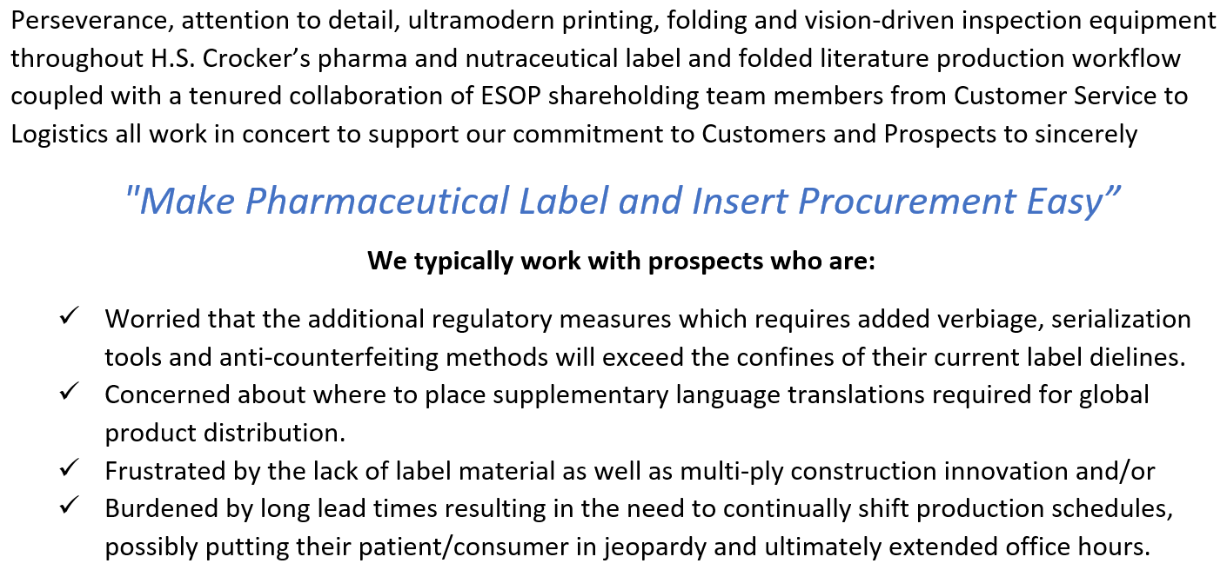
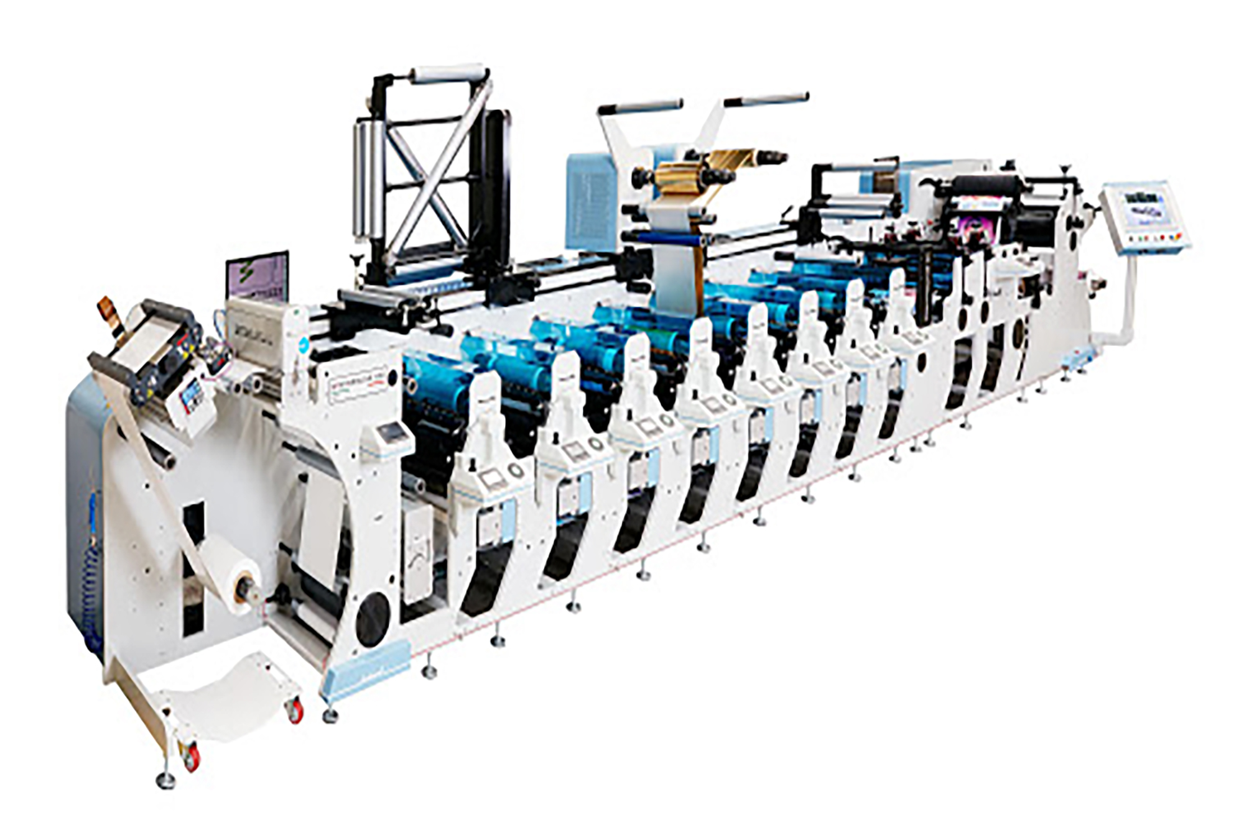
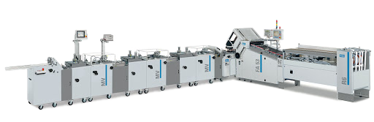
Pharma & Nutraceutical Labels
Inserts, Onserts and Enclosures
400 Eagleview Blvd., Suite #106 Exton, PA 19341 (610) 458-7434 Kevin White, Sales Manager: kwhite@hscrocker.com

Slide 2

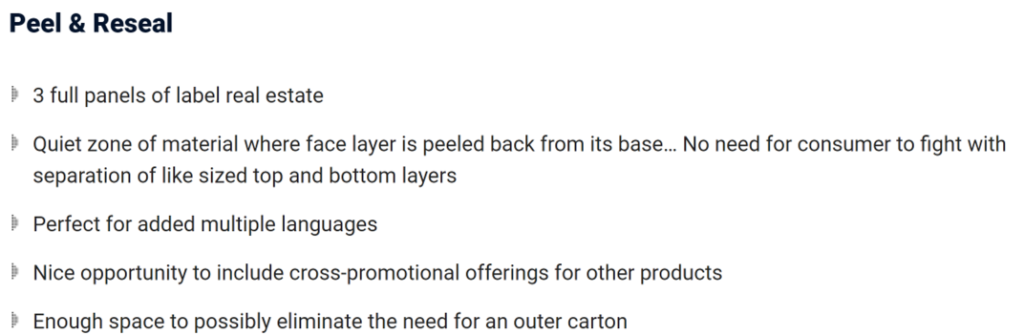
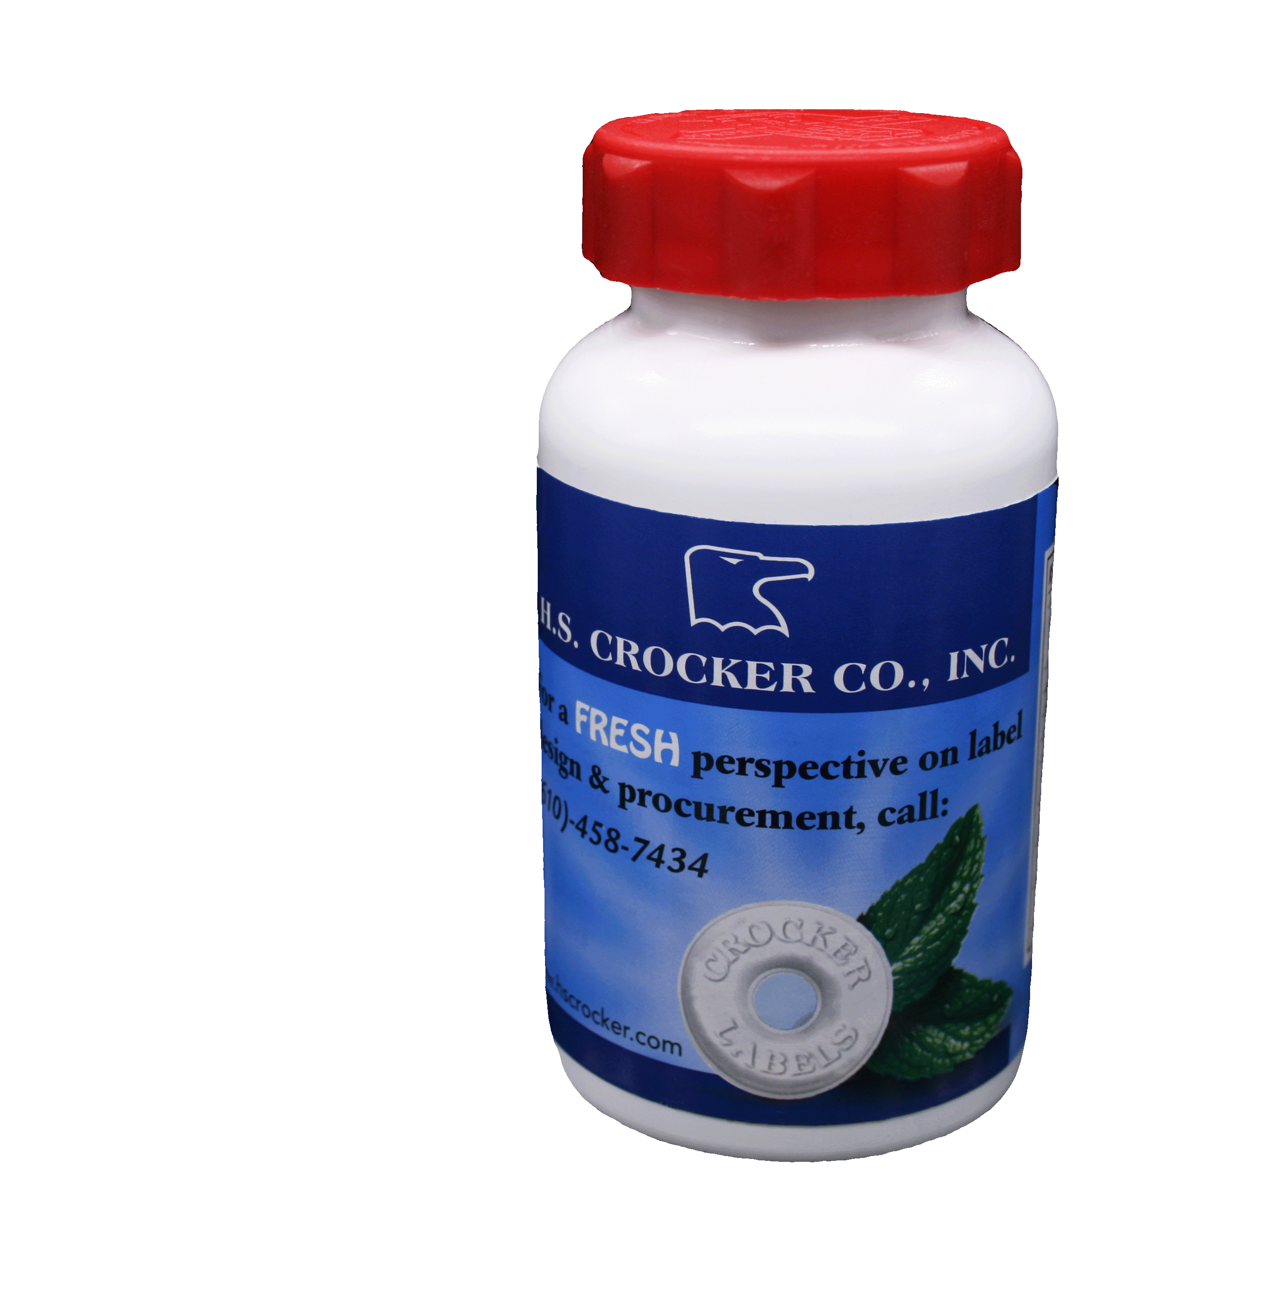
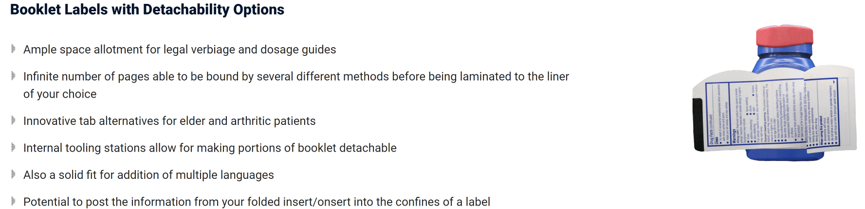
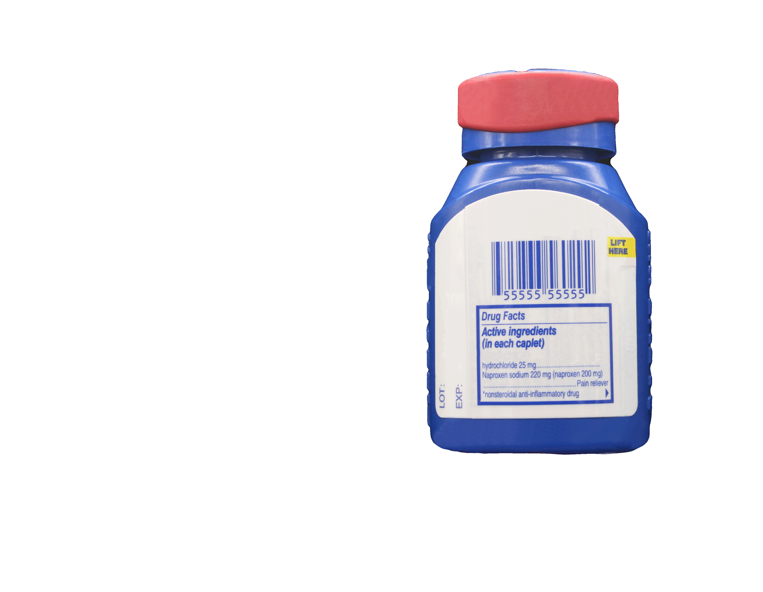
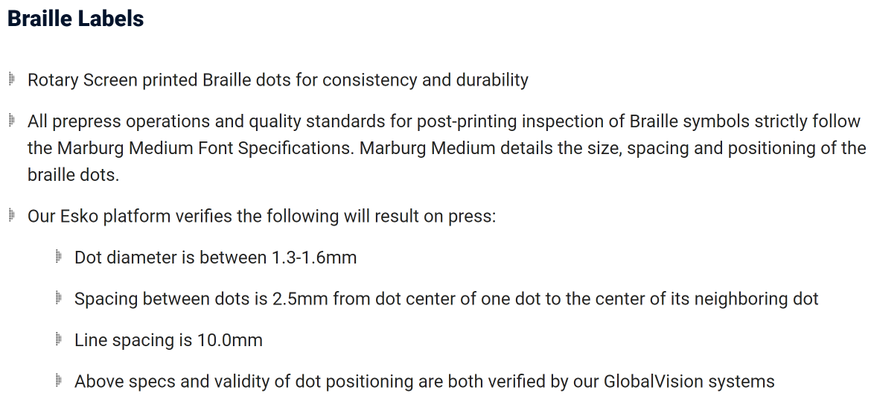


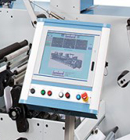
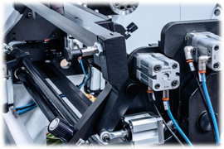
Supplemental Capabilities: Letterpress, UV Flexo, Rotary Screen and Digital Printing Processes utilized individually or in combination, Exclusive use of Low Migration Adhesives and Inks, Cold Foil Stamping, Backside Printing, Sequential Numbering and Unsupported Film for Shrink Sleeves
Extremely Quick Makereadies & even faster setups for repeat items
Electronic Platform set to Synchronize
settings from initial run to re-orders
Pneumatic Controls – An innovative method to prevent traditional print defects
400 Eagleview Blvd., Suite #106 Exton, PA 19341 (610) 458-7434 Kevin White, Sales Manager: kwhite@hscrocker.com

Slide 3
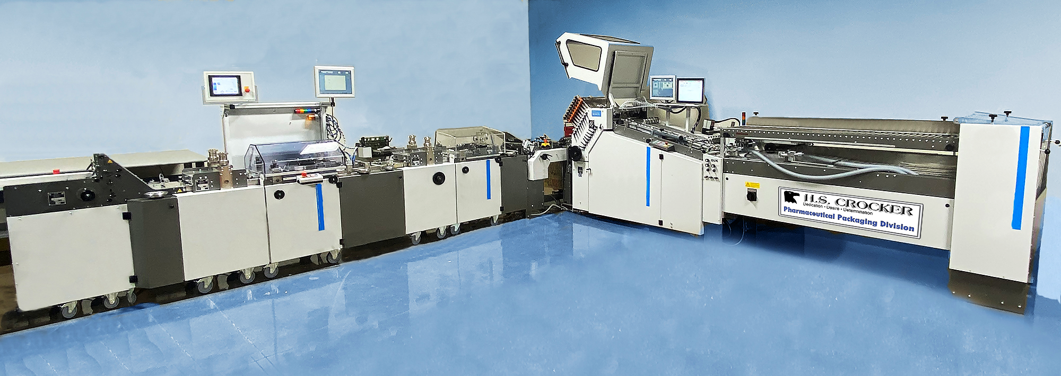
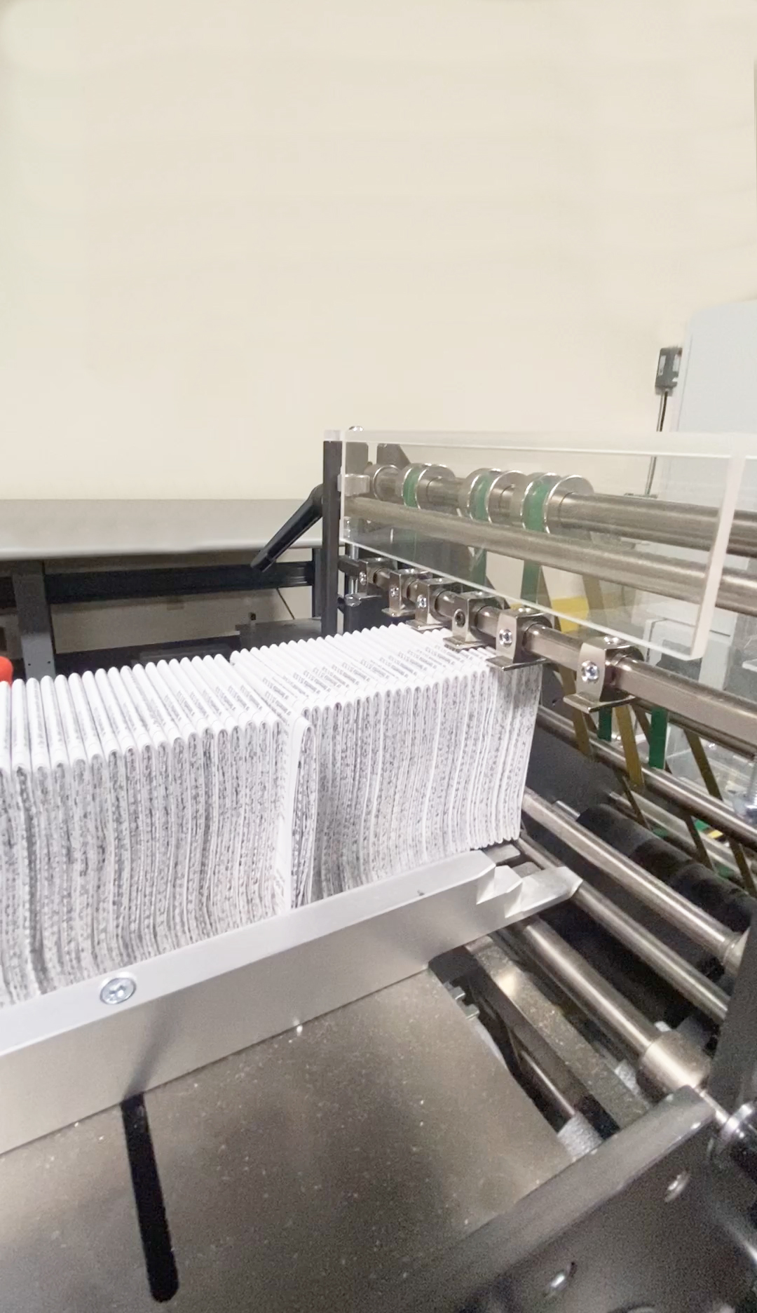
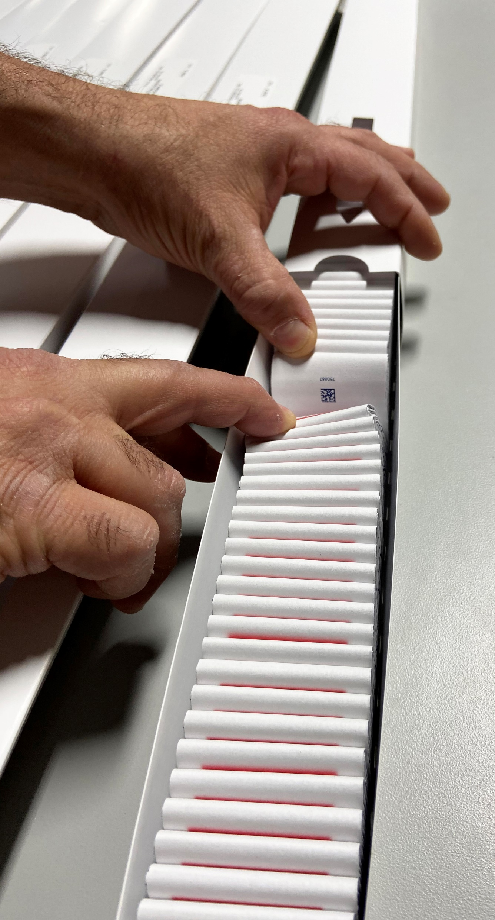
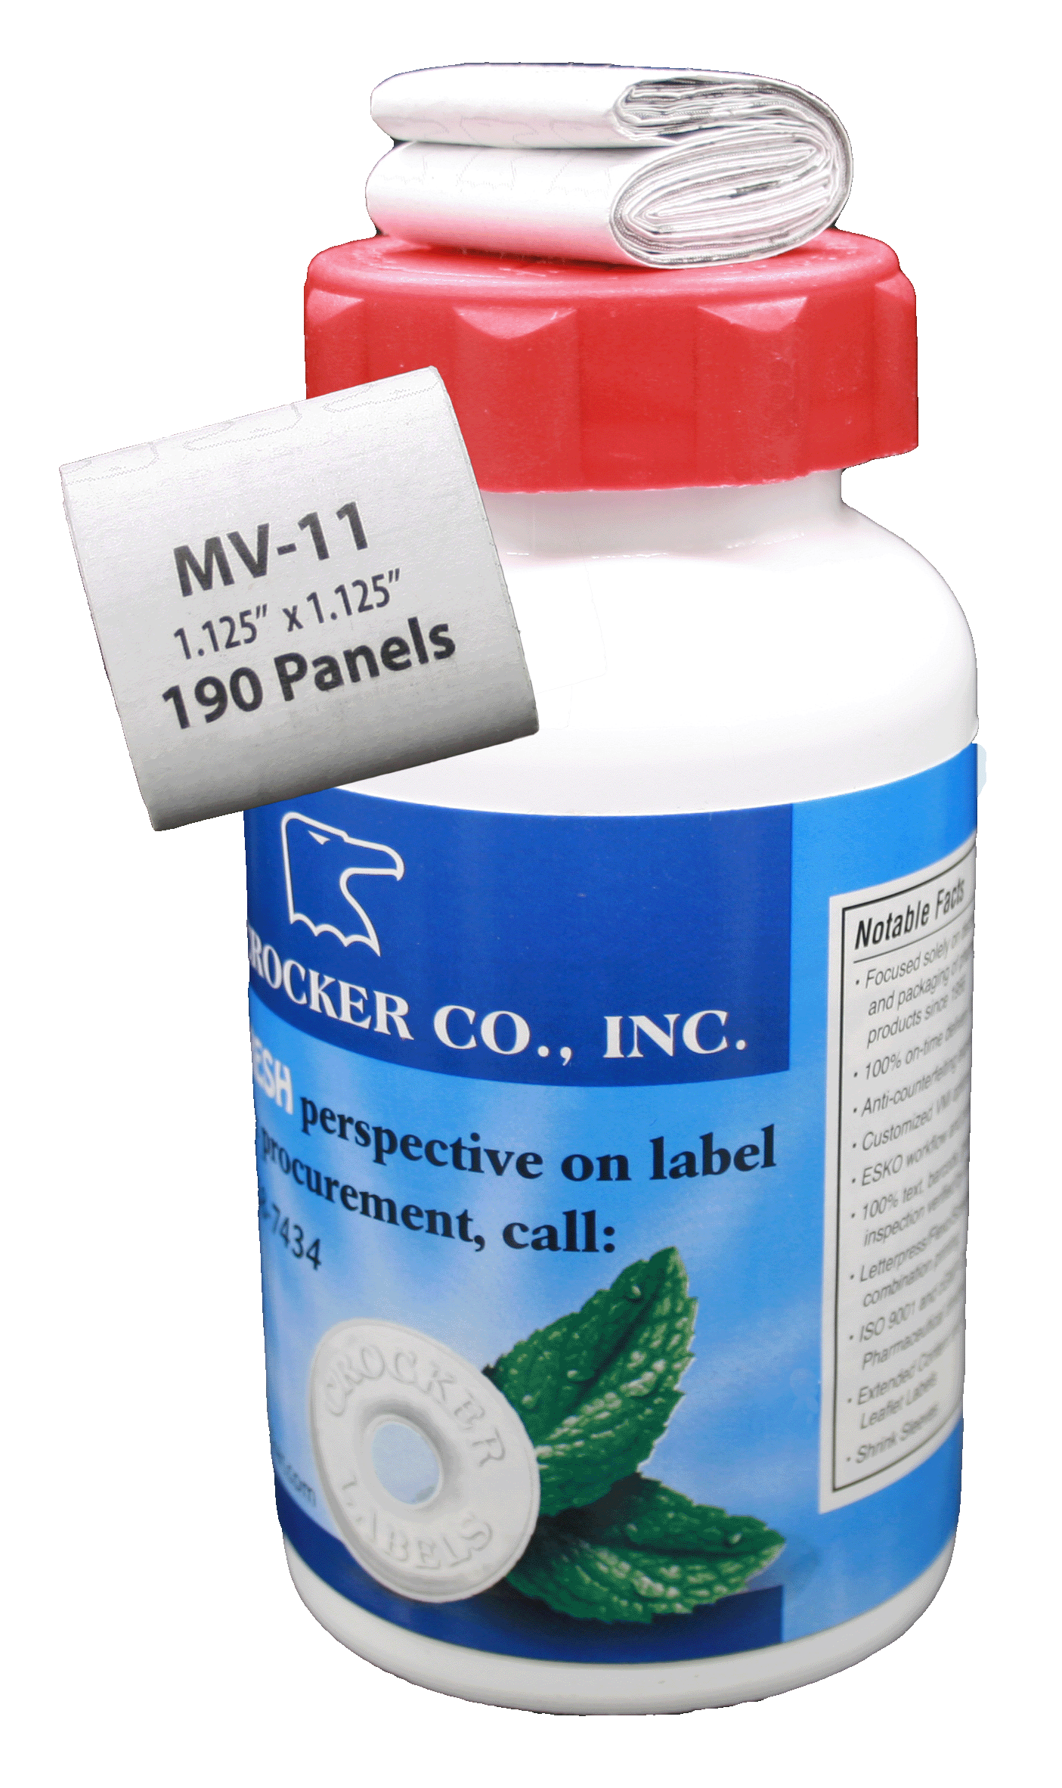
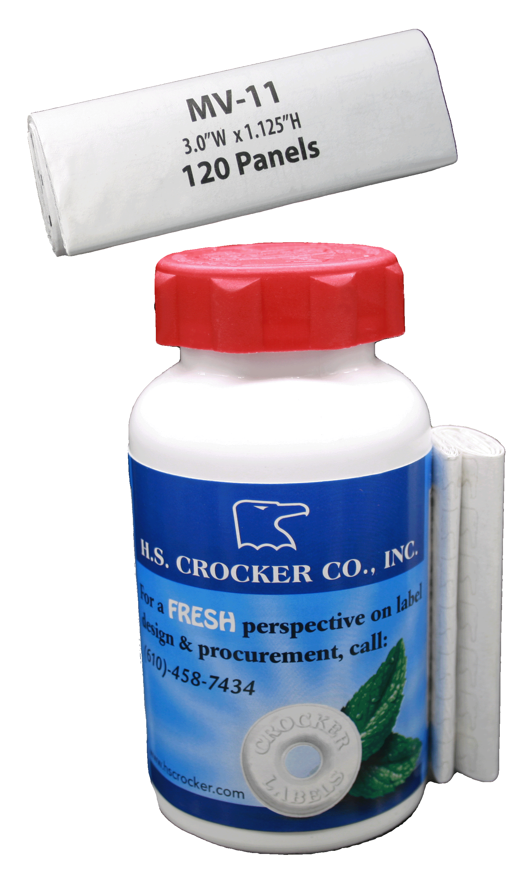
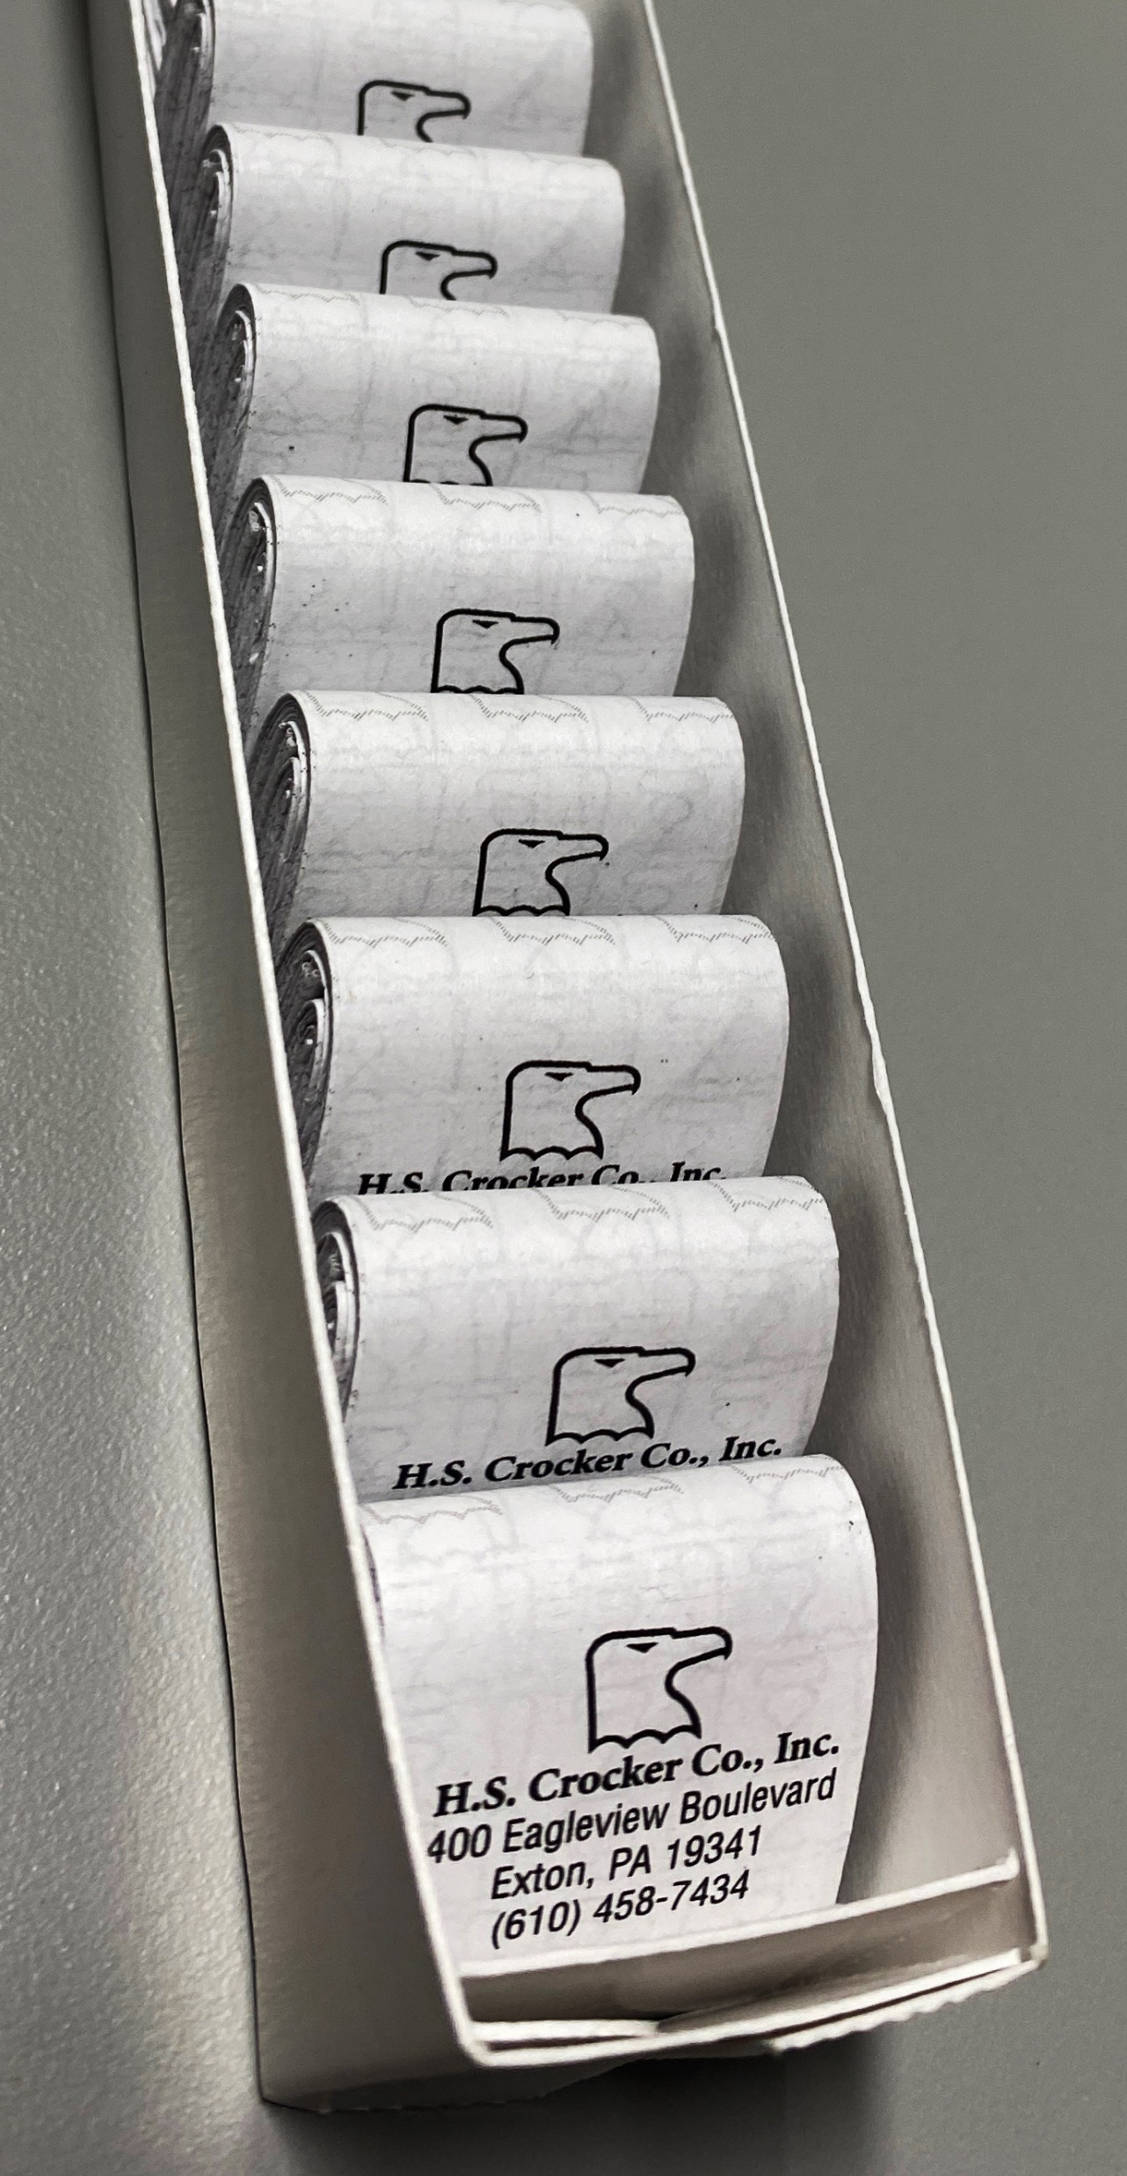
Inserts, Onserts and Enclosures
Pharmaceutical Folded Literature Folding Parameters:
Maximum sheet size 20.75” (530mm) in width x 56-11/16” (1440mm) in length Minimum sheet size 6-1/4” (160mm) in width x 8-1/4” (210mm) in length
Minimum finished fold size for RTA Outserts = 1.125” (29mm) X 1.125” in height or 2” (51mm) in width by 1” (25.4) in height
Maximum finished fold size = 6” in (152mm) width by 3” in height (77mm)
400 Eagleview Blvd., Suite #106 Exton, PA 19341 (610) 458-7434 Kevin White, Sales Manager: kwhite@hscrocker.com

Slide 4



Anti-Counterfeiting, Brand Protection & Consumer Engagement
H.S. Crocker works diligently to stay current with the latest offerings in Security Printing techniques. In today’s marketplace, security printing methods have become a key component of product safety and traceability while these methods will soon be required.
We lead the industry in providing our customers with dynamic and effective security features. These features enable our customers to provide brand protection and marketplace confidence by ensuring product verification. Our research has positioned H.S. Crocker with the ability to offer a broad range of overt, covert and even forensic security solutions.
We can assist by helping you:
Improve Visibility within your Chain of Custody with innovative tracking and traceability?
Complete traceability of materials from our supply chain and throughout our process in concert with your serialization software and variable imprinting equipment?
Support Blockchain Technology, IoMT Compliant Packaging and RWD?
Provide Inventive and Effective Brand Protection Solutions?
Be constantly armed with the latest information and tools necessary to maintain your FDA compliance relating to the ever-changing demand of global serialization?
Establish or increase Patient Engagement with apps, coupons and methods proving any given product’s authenticity and a link to like products?
Implement dependable Smart Labeling alternatives to monitor Biosimilars, Vaccines and other pharmaceuticals requiring Cold-Chain Logistics?
Printed, Folded and Uniquely Packaged Inserts in Just 3 Weeks or Less!!
400 Eagleview Blvd., Suite #106 Exton, PA 19341 (610) 458-7434 Kevin White, Sales Manager: kwhite@hscrocker.com

